Slide 1
STARS Financial Command Center - NorthStar Health Plan
Our demo will follow a fictional plan, "NorthStar," with population of 50k members that has just dropped from 4.0 to 3.5 Stars. We will walk the client through a journey from the C-Suite down to the frontline, showing how we can support diagnoses of the problem and orchestrate the solution.
Stars performance is at risk: CY Star Rating: 3.5 (below target for margin and QBP eligibility)
HEI Scorecard signals concern: Status: Below Average (equity gaps persist, jeopardizing rewards)
QBP eligibility is not secured: Not Eligible (current risks incentive loss)
Financial exposure is significant: Revenue Impact: Risk −$30M
Chief Quality Officer mandate: Must prioritize data-driven strategies to assess the financial landscape and identify actionable insights for improvement for Next Year
Notes:
Leadership is asking for financial control. With the HEI Command Center, we can see next year’s Stars and HEI before CMS does—and simulate how to change it.
On one hand, we slide assumptions—screenings, adherence, vaccines—and the system recalculates both Projected Stars and HEI.
On the other, we translate it into action: baseline 3.5 moving to 4.0, an HEI scorecard that’s below average and not on track unless we act, and what that means for QBP eligibility.
Most importantly, the financials: turning −$50M risk into +$45M opportunity under the targeted scenario. Numbers here are illustrative and update live from the What‑If panel.

Slide 2
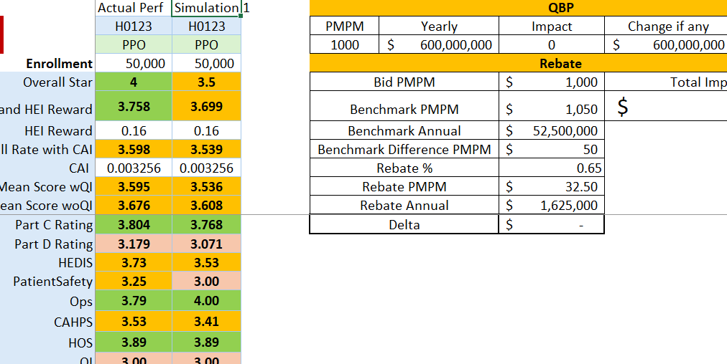
Act I: From Chaos to Financial Command
What we will do differently
Model the business before spending: Use the What‑If Scenario Planner to test screening/adherence/vaccine levers and instantly see the STARs & HEI impact.
Pinpoint and Address the Drivers of Inequity: Target equity efforts for maximum impact by identifying the SRF micro-cohorts with the largest care gaps. Use SDOH analytics to pinpoint the root social and economic barriers to deploy outreach programs.
Scenario Planner
What success looks like
Projected Star Rating: → 4.0 (with targeted intervention)
HEI Scorecard: → On Track (close priority disparities)
QBP Eligibility: → Eligible (scenario‑dependent)
Financial Outcome: → Opportunity ~$32M
Notes:
Assessment Center is the “brain” of adaptivity and efficiency. It enables confidence-based early stopping—no over-questioning. It leverages real-time EMR data, prior answers, and payer rules. It’s the main differentiator from legacy systems and static forms.
“Low‑Back‑Pain MRI, adaptive flow”
Order placed in EMR; CRD indicates PA is needed and launches DTR.
DTR app auto‑resolves Centene from Coverage; fetches the LBP Questionnaire package.
The app runs CQL to pre‑fill prior conservative therapies, recent pain scores, and diagnosis from the chart.
Assessment Center sees sufficient evidence for certain criteria and serves a short segment:
Q1: confirm duration of symptoms (pre‑filled default; clinician verifies)
Q2: confirm failed PT within last 6 weeks (CQL found PT notes; clinician attests)
Q3: red‑flag screen (neurologic deficit)—clinician marks “No”
Confidence threshold reached → stop (no remaining 27 questions)
(“30 → 4” is User‑provided exemplar; behavior matches confidence‑based stop.)
The completed QuestionnaireResponse is saved in EMR; the back‑office uses it in PAS $submit; payer confirms and returns Response.

Slide 3
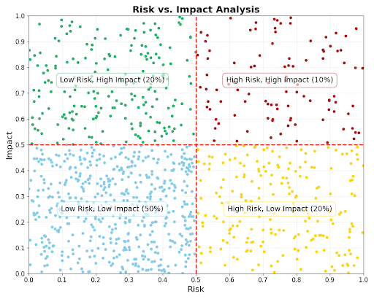
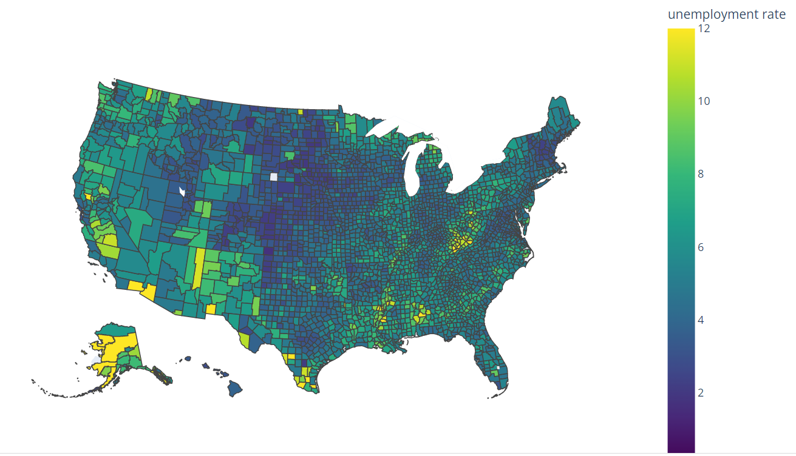
Act 2: Analyst View: From Disparity to Actionable Insight
Measure Disparity Analysis
Predictive Risk Stratification
Geospatial & SDoH Overlay
High concentration in 3 zip codes, driven by: - Lack of public transport - Food desert status
Identify and prioritize measures where targeted improvement yields maximum stars impact.
AI pinpoints the small cohort of members driving majority of the gap combined with the likelihood to respond to targeted interventions.
The challenge isn't everywhere – its concentrated and solvable.
"We found the WHY. The problem is localized, concentrated and actionable."

Slide 4







Act III: From Insight to Action: Smart Workbench
Hidden barriers surfaced automatically → more empathetic, more effective outreach.
From 1,000 members to the top 50 today (ranked by Impactability).
Care teams act faster and smarter—with measurable impact
Next Best Action
Detected barriers from SDOH
member lives in a transportation desert and uses supplemental grocery cards
Mail at-home - 82% predicted success
Offer transportation to clinic - 65%
Detected barriers from prior conversation
"I have transportation issues"
"Anxious about screenings"
Follow-up call in 7 days - 57%
Why these? Learned from detected barriers and member‑level impactability scores.
Every outreach is evidence‑based—no guesswork.

